Slide 1

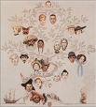
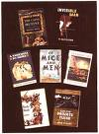
American Literature
Kasi, Feroze Qaiser

Slide 2

Introduction to Thematic Unit
Unit Theme : American/ English Literature
Target Students : EFL College and adults.
Linguistic Background : Various Nationalities
Language Level : Intermediate
Meeting Time : Twice a week for 3 hours
Length of Unit : 3 Weeks

Slide 3
Unit Overview
Lesson 1 : Movie based on American Novel
- Part 1 : Exploring Movie Based on Novel, “A Tree Grows In
Brooklyn” by Betty Smith
- Part 2 : Creating a biography of the main character in movie
Lesson 2 : Biographies of Famous American Literary Figures
- Part 1 : Exploring biography of famous American literary figure,
Agatha Christie
- Part 2 : Discussing the influence of life of Agatha Christie on her
writing
Lesson 3 : American Poetry
- Part 1: Exploring and defining aspects of American Poetry
- Part 2: (Continued)
Lesson 4: American Short Stories
- Part 1: Exploring American Short Stories.
- Part 2: (Continued)

Slide 4

Lesson # 1
Movie based on American Novel
Part #1 Objective : Exploring Movie Based on Novel, “A Tree Grows in Brooklyn”
by Betty Smith
• Introduction to class including warm-up : 15-20 min.
- Brainstorming for movies set in New York
- Playing a video clip on “Williamsburg tour” with the song “Molly
Malone,” that is sung by James Dunn in the movie, “A Tree Grows in
Brooklyn”.
http://www.youtube.com/watch?v=7J4Q-u_jK_Q
Procedures: 50 min.
- Playing a video clip of one of the scene of the movie
- Completing the cloze exercise while the watching the video clip for the second time
- Providing the students with transcript to check their answers
Closure : 10 min.
- Group Project::The teacher gives the copy of the next scene of the novel and asks the students in groups to develop dialogue from it which they will act out in the next class .

Slide 5

Movie based on American Novel (continue)
Part 2: Objective : Creating a biography of main
Character of the Movie.
Warm-up : 5-10 min.
- Ask students what they remember about the last lesson, and
have them talk in groups about the two questions;
What kind of impact does the character have on you?
Which character do you like and why?.
• Procedures :60-65 min.
- Have students go on to http://www.biography.com and
explore the website called “Biography”.
- Have them read one of the biographies, and ask
them what sort of information is included.
-Ask students to make a similar biography of their favorite
character using Power Point
• Closure : 5-10 min.
- Explain to the students that if they didn’t finish their biography, they have to finish it and e-mail it to the teacher before the
next lesson.

Slide 6

Lesson #2
Biographies of Famous American Literary
Figures
Part 1: Objective : Exploring biography of famous American literary figure,
Agatha Christie
• Introduction to class including warm-up : 35 min.
- Ask students if they know what a biography is. Have students go onto
http://www.biography.com/ Explain what this website is about.
- Brainstorming about detective stories in general (definition of the
literary genre, vocabulary, plot).
- The teacher provides a definition of a mystery story.
- Ask students if they know anything about Agatha Christie (her life,
novels, etc.) The teacher points out that the author was half-American
(her father was American, her mother was British).
• Procedures : 45 min.
- Have students read a biography of Agatha Christie, The students will read
the novel of this author in their literature class next week.
- Divide the students into groups of four and ask them to discuss specific vocabulary used i
in the reading that are related to detective stories.
- Give students a close exercise based on the reading and ask the students to fill the
missing words.
- Once the students are done with this activity, the teacher tells them to check their
answers by re-reading the biography.
• Break: 20 min.

Slide 7

Biographies of Famous American Literary
Figures (Continued)
Part 2: Objective : Discussing the influence of life of Agatha Christie on
her writing
• Warm-up : 30 min.
- After the break students are asked to make a list of some detective stories that they know and write a short description of each (author, main characters, and plot summary)
- Teacher divides the students into groups of four and asks students to share their lists with other group members.
• Procedures : 30 min.
- The teacher asks students to discuss the biography reading in terms of how Agatha Christie’s life and personality influenced her writing.
- Subsequently, the teacher initiates and invites students to a class discussion about the life of Agatha Christie
- The teacher reviews key vocabulary and sums up the lesson in a few sentences by talking about Agatha Christie’s ongoing popularity in the United States and in the world. .
. Classroom assignment: (15-20 min)
- Ask students to start writing about why they might like or dislike mystery stories.
. Homework:
- Research at least one American author who wrote mystery stories and was influenced by the writings of A. Christie.

Slide 8

Lesson #3
American Poetry (byEmad)
Part 1: objective: Exploring and defining different of aspects of American Poetry
Warm up : 20 min
-Teacher will distribute “Poem’s web cluster” (a paper developed by the
teacher). Students are divided into groups of four students and start
brainstorming about their favorite topics in reading poetry. Students write
down the words they come up with, then cluster them under topics in the
sheet paper.
-Teacher begins eliciting topics and words from students and write them on the board.
Procedures: 60 min
-Teacher present the key vocabulary on the board through eliciting what
students already know and facilitates the meaning of the new words
through meaningful examples.
-Teacher starts showing number of (my favorite poem) project video
segments (about 6 to 8 video segments about 4 min each) the segments
show selected poems read by different students and their reflections about
the poems, why they chose them and how the poems relate to their lives.
-Teacher asks students to write a response to the segment that influenced
them most strongly or that they feel related to their lives and feelings.
-Teacher discusses what students liked or did not like most in each video,
what they noticed, what they enjoyed and what they did not understand.
Break : 20 min

Slide 9

American Poetry
(continued)
Part 2 objective: Exploring and defining different of aspects of American Poetry
Procedure: (Continued)(60min)
After the break ,teacher discusses and explain the difficult words in the
poems through example and poetic contexts.
Teacher asks students if there is a poem they know well enough to
share with the class.
students are encouraged to recite any poems they know.
Invite students to find a poem they like, read it to the class, and talk
about why they like it.
then provide time to the students to find their poems. Tell students they
should write out the poem clearly and look up any new or difficult words in the poem and prepare definitions.
Read the poem aloud many times to practice reading and listening to
the sounds.
Reflect on how the meanings of the poems are significant to them
personally.
Students are encouraged to share their poems and speak about what
attracted them to the poems.
Follow up activity (20 min)
- Students will work in pairs to create videos of their poetry readings.
-· Students will share their videos with other classrooms.
Assessment
Students will be evaluated on their participation in the various activities.

Slide 10

Lesson#4
American Short Stories
Part 1:Objective: Exploring American short stories
Warm-up Activity: Introduce the prepared realia and
identify them to the students. (5-10 min)
Procedure: (60min)
- Teacher sticks the new vocabulary cards with definitions
on the board and students grab the definition tags and
stick it to the matching realia.
- Watching the video clip:
- After watching the video clip, teacher asks basic questions and students answer them to show their level of
understanding.
- Cloze Exercise: Students are provided with the text with
blanks to fill out when watching the video for the second
time.

Slide 11

American Short Stories
(Continued)
Part 2:Objective: (Continued)
Guided Participation (Practice)
a. Pair work: Comprehension exercise
b. Group work: Critical thinking exercise
Homework: Students are provided with the internet link and they select any
interesting video clip to watch and write one summary paragraph .
Evaluation
- Teacher calls each group to present their answers and opinion from the
exercises: Everyone in each group is given a chance to speak when presenting.
Extension/ Expansion
a. Map activity: Teacher provides the students with map and have them
draw the right direction
b. Role play: Students in pair take role to give and get direction to school
facilities.

Slide 12
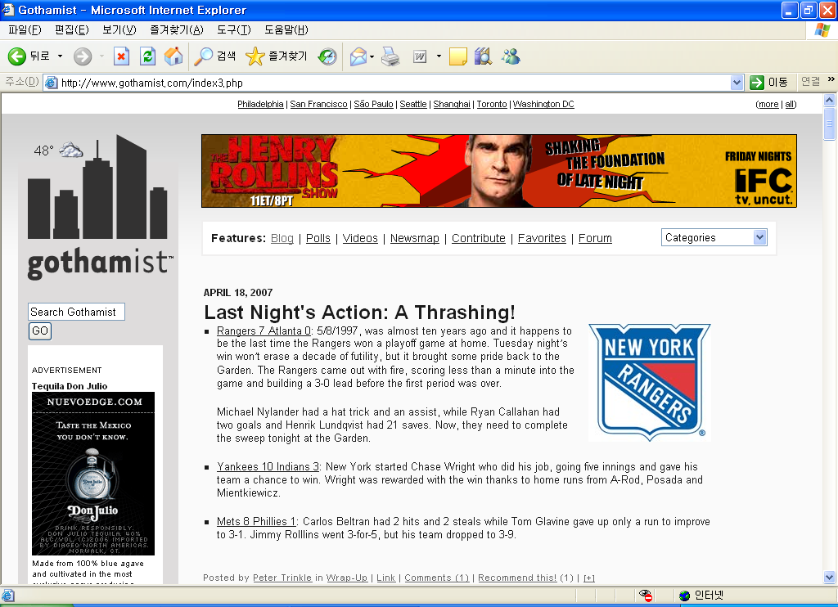
Wrap-up
Objective : Lesson on how to create a blog and putting students’
works on it
• Warm-up : 15 min.
- Students brainstorm ideas about a blog
- Teacher show some examples of blogs
• Procedures : 55 min.
- Students learn how to create a blog
- Students put all of their works on their blogs
• Closure : 20 min.
- Students talk about this thematic unit
- Teacher comments on students’ performances on this thematic unit.

